Slide 1

Experiment 1:
Group1: Nrf2-/-, AIN93M (N=9)
Group2: Nrf2-/-, PEITC (N=9)
Experiment 2:
Group3: WT, AIN93M (N=5)
Group4: WT, PEITC (N=5)
Experiment 3:
Group5: WT, AIN93M (N=5)
Group6: WT, AIN93M, DSS (N=5)
Group7: WT, Cranberry, DSS (N=5)
Group8: WT, PEITC, DSS (N=5)
Group9: Nrf2-/-, AIN93M (N=5)
Group10: Nrf2-/-, AIN93M, DSS (N=5)
Group11: Nrf2-/-, Cranberry, DSS (N=5)
Group12: Nrf2-/-, PEITC, DSS (N=5)
AIN93M : Groups 1, 3, 5, 6, 9 and 10
AIN93M: Groups 2, 4,
7, 8, 11 and 12
AIN93M + 0.05% PEITC Groups 2, 4,8 and 12
AIN93M + Cranberry: Groups 7 and 11
X
X
X
X
X
X
Week 0 1 2 4 5 6 8
Gut microbiota equalization period (2 weeks)
Figure 1: Experimental design. Mice fecal samples for the 16S sequencing were collected individually at 3 timepoints – at the end of the 2-week equalization period (Week 0), at an early timepoint (Week 1) and at a late timepoint (Week 4 or Week 8). Samples used for metabolite analysis were collected at an early and a late timepoints (Weeks 2 and Week 6 respectively).
Notes:
Experiment 1 (Exp01) = Nov18
Experiment 2 (Exp02) = May19
Experiment 3 (Exp03) = Sep19

Slide 2
Supplemental Figure 1: 16S sequencing depth (total number of hits per sample).

Slide 3
Supplemental Figure 1: 16S sequencing depth (total number of hits per sample).

Slide 4
A
B
Figure 2: Alpha diversity measured by Shannon index. (A) Averages of Shannon indices calculated on raw OTU numbers and (B) on corrected OTU numbers (OTU+1).

Slide 5
A
B
Figure 2: Alpha diversity measured by Shannon index. (A) Averages of Shannon indices calculated on raw OTU numbers and (B) on corrected OTU numbers (OTU+1).

Slide 6
A
B
Supplemental Figure 2: Shannon index vs. sequencing depth.

Slide 7
A
B
Supplemental Figure 2: Shannon index vs. sequencing depth.

Slide 8
Supplemental Figure 3: logit of the relative abundance of Phylum vs. sequencing depth.

Slide 9
Supplemental Figure 3: logit of the relative abundance of Phylum vs. sequencing depth.

Slide 10
Figure 4: Biplot of logit relative abundance of Phylum

Slide 11
Figure 4: Biplot of logit relative abundance of Phylum

Slide 12
Figure 5: biplot of logit relative abundance of Phylum in Exp03 only

Slide 13
Figure 6: Biplot of logit relative abundance of bacterial classes

Slide 14
Figure 6: Biplot of logit relative abundance of bacterial classes

Slide 15
Figure 7: biplot of logit relative abundance of bacterial classes in Exp03 only

Slide 16
A
B
Figure 8: Means of log2 F/B ratios by genotype and diet over time in Exp03. The bars represent standard errors of log2(F/B) ratios.

Slide 17
A
B
Figure 8: Means of log2 F/B ratios by genotype and diet over time in Exp03. The bars represent standard errors of log2(F/B) ratios.

Slide 18
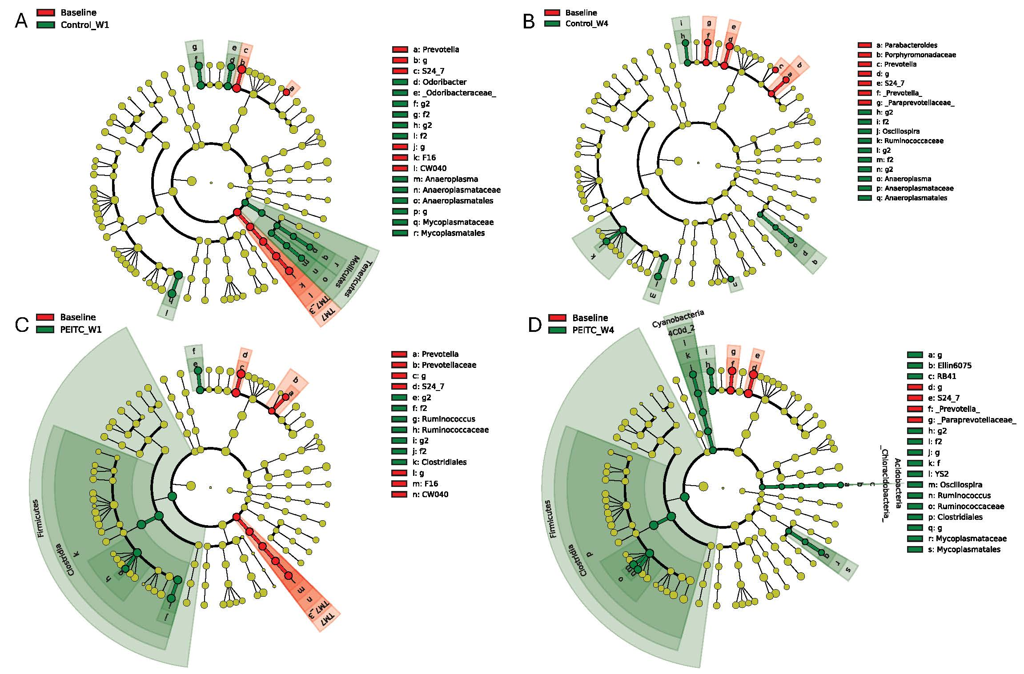
Figure 9: Linear discriminant analysis Effect Size (LEfSe) analysis of aging and PEITC dietary additives effect.

Slide 19
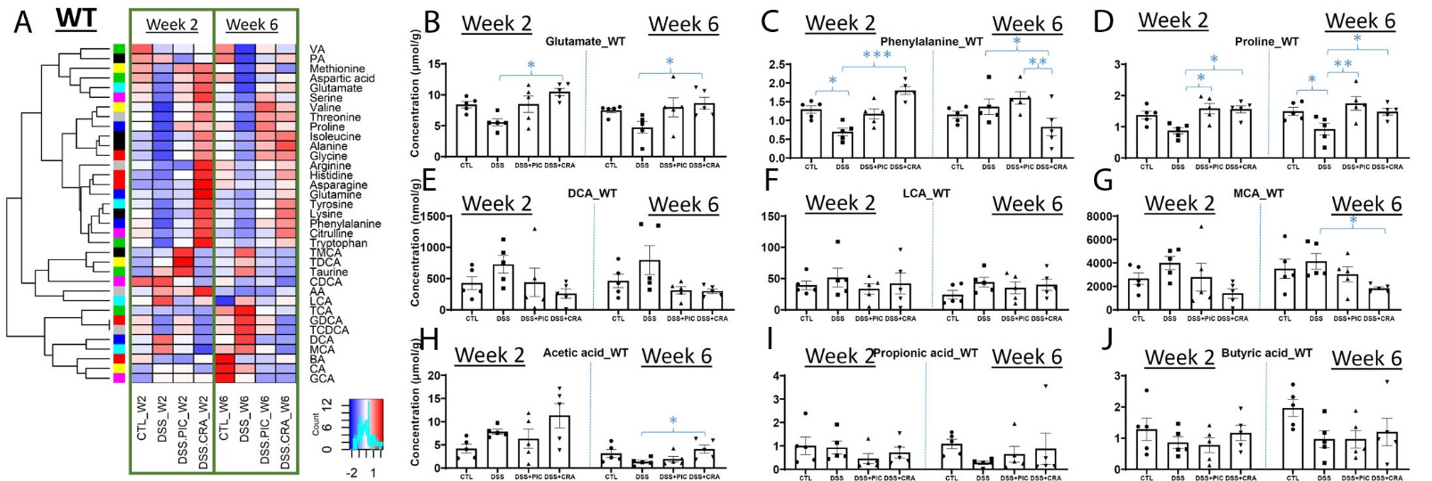
Figure 10: Effects of DSS, PEITC and cranberry cotreatments on fecal metabolome of WT mice. Fecal samples collected at week 2 and 6 of 4 treatments, including control (CTL), DSS, DSS+PEITC (DSS+PIC), and DSS+cranberry (DSS+CRA), were analyzed by 4 LC-MS methods (143). The concentrations of amino acids, bile acids, and SCFA were quantified. (A) A heatmap on the distribution of amino acids, bile acids and SCFA in fecal samples from 4 treatments. (B-D) Concentrations of major amino acids, including glutamate, phenylalanine, and proline. (E-G) Concentrations of major bile acids, including DCA, LCA, and MCA. (H-J) Concentrations of major SCFA, including acetic acid (AA), propionic acid (PA), and butyric acid (BA).

Slide 20
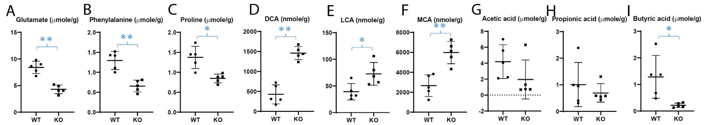
Figure 11: Differences in fecal metabolite profile between WT and Nrf2-null (KO) mice. The concentrations of amino acids, bile acids, and SCFA were quantified in the fecal samples from untreated WT and KO mice (143). (A-C) Concentrations of glutamate, phenylalanine, and proline. (D-F) Concentrations of major bile acids. (G-I) Concentrations of major SCFA.

Slide 21
A
B
C
Figure 12: Biplots of amino acids (A) and SCFA (B) by diet, and bile acids (C) by genotype.

Slide 22
A
B
Figure 13: Biplots of bacterial metabolites based on the results of PCA on combined data with concentrations of amino acids, SCFA and bile acids by diet (A) and genotype (B).

Slide 23
Forward Primer | Reverse Primer
515F (Parada) | 806R (Apprill)
GTGYCAGCMGCCGCGGTAA | GGACTACNVGGGTWTCTAAT
Supplemental Table 1: V4 primer sequence used for 16s RNA sequencing library preparation

Slide 24
Kingdom | Experiment 1: Nrf2 KO Mice | Experiment 2: WT Mice | Experiment 3: WT and Nrf2 KO | Combined
Bacteria | 10,197 (94.78%) | 7,994 (98.34%) | 7,558 (96.07%) | 22,251 (95.73%)
Eukaryota | 472 (4.39%) | 116 (1.43%) | 232 (2.95%) | 812 (3.49%)
Archaea | 4 (0.04%) | 0 (0%) | 2 (0.03%) | 6 (0.03%)
Unknown | 86 (0.80%) | 19 (0.23%) | 75 (0.95%) | 175 (0.75%)
Table 1: OTU mapping to Kingdoms. Number of OTUs found in each experiment (% total).

Slide 25
Predicted diet and DSS challenge (PC1+PC2+PC3+PC4+PC5) | Observed diet and DSS challenge
 | DSS+AIN93M | No DSS+AIN93M | DSS+PEITC | DSS + Cranberry
DSS + AIN93M | 15 | 3 | 5 | 0
No DSS + AIN93M | 2 | 10 | 4 | 4
DSS + PEITC | 3 | 5 | 9 | 2
DSS + Cranberry | 0 | 2 | 2 | 14
Table 2: multinomial regression predictions of treatment groups by microbial metabolite PCA

Slide 26
Predicted genotype (PC1+PC2+PC3+PC4+PC5) | Observed genotype
 | Wild Type | Nrf2 KO
Wild Type | 33 | 12
Nrf2 KO | 7 | 28
Table 3: multinomial regression predictions of genotype by microbial metabolite PCA

